Slide 1
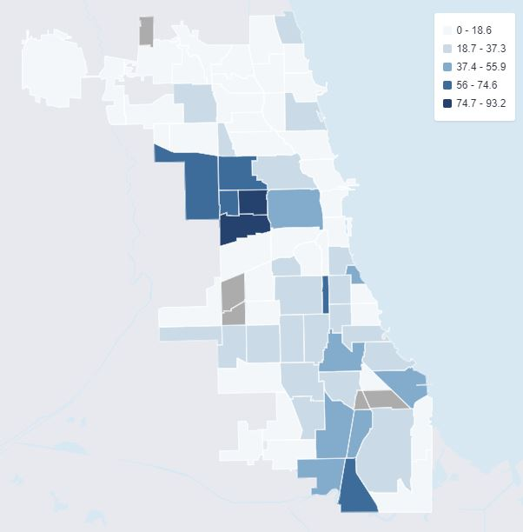
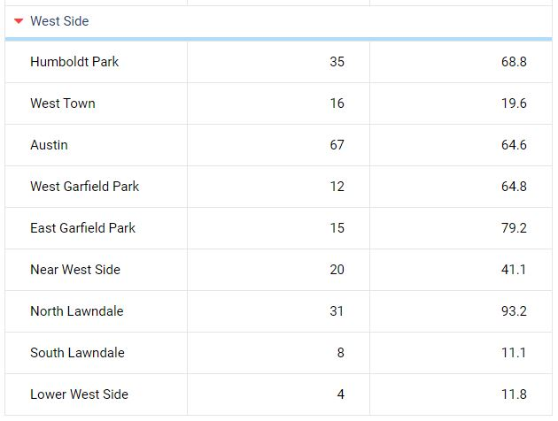
Chicago Opioid Overdose Deaths by Community Area - 2017
https://www.chicago.gov/content/dam/city/depts/cdph/CDPH/Healthy%20Chicago/ChicagoOpioidReport2018.pdf
https://www.chicagohealthatlas.org/indicators/opioid-related-overdose-deaths; Age-adjusted rate of opioid-related overdose deaths per 100,000 population; Source: Cook County Medical Examiner's Office; US Census Bureau, 2010 and 2000 census; 2017 rates: IL:17.2;Chi:29.1; Lincoln Park:6.5

